Slide 1
Employee Data Analysis using Excel
STUDENT NAME: SK. RITHIKA SARAN
REGISTER NO: 312216191
DEPARTMENT:B.COM- BANK MANAGEMENT
COLLEGE : SHRI SHANKARLAL SUNDARBAI SHASUN JAIN COLLEGE.

Slide 2
PROJECT TITLE
Employee Performance Analysis using Excel

Slide 3


AGENDA
Problem Statement
Project Overview
End Users
Our Solution and Proposition
Dataset Description
Modelling Approach
Results and Discussion
Conclusion
3/21/2024 Annual Review

Slide 4

PROBLEM STATEMENT
Goal of this the project is to analyze employees data to uncover trends, disparities, and patterns that can inform decision-making for both employers and employees.

Slide 5

PROJECT OVERVIEW
Employee data analysis means analysing the
Employees data using excel by
Categorizing them by name , gender, employee unit
Performances etc
.

Slide 6
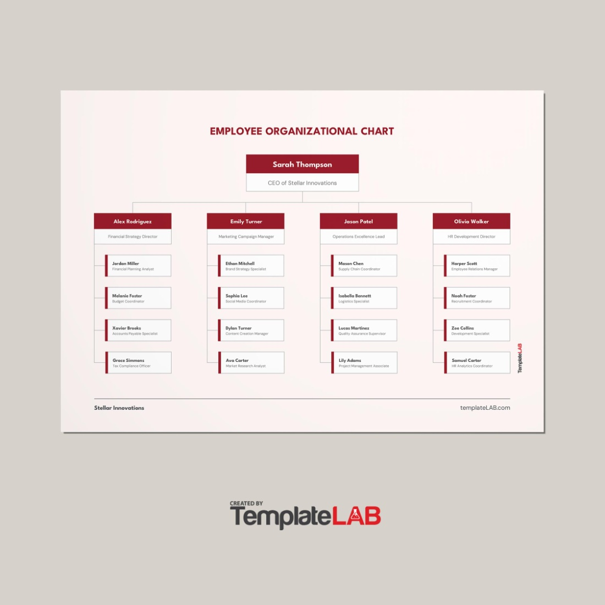
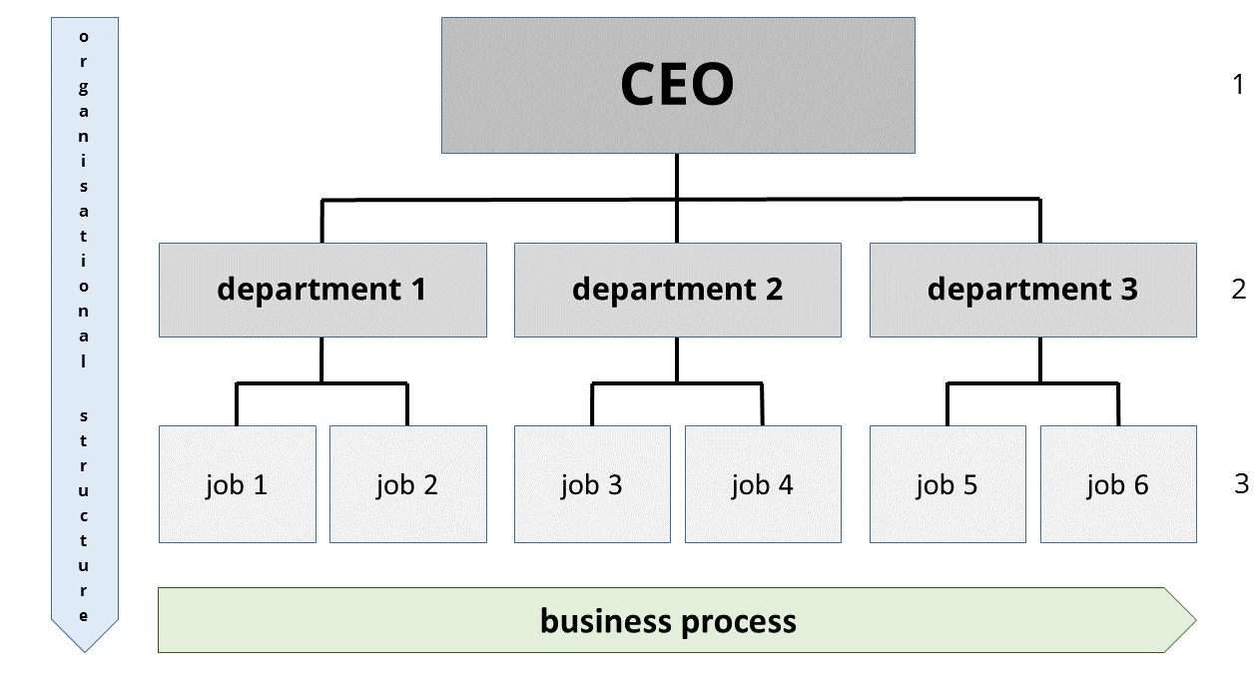

WHO ARE THE END USERS?

Slide 7

OUR SOLUTION AND ITS VALUE PROPOSITION
FILTER – remove other department employees
FORMULA – to know who is getting paid highly
PIVOT – summary
GRAPH – data visualization

Slide 8
Dataset Description
KAGGLE
9 FEATURES
EMPLOYER ID
NUMERICAL VALUE
NAME
PERFORMANCE LEVEL
GENDER – MALE / FEMALE
EMPLOYEE RATING

Slide 9

THE "WOW" IN OUR SOLUTION
Employee data;
=IFS(Z8>=84,309,”HIGH’,Z8>=50,310,
“MEDIUM”,Z8>=50,449,”LOW”.)
3/21/2024 Annual Review
9

Slide 10
MODELLING
DATA COLLECTION
Employee Data
FEATURE COLLECTON
Name
Employee ID
Department
Gender
Salary
10

Slide 11
RESULTS
11

Slide 12
conclusion
We have concluded the employee data using excel.
We have seen how to fetch and where to gather data
And also how to create pivot table and also alligned
The employees datas.
Thank you!!

